Slide 1

GROUP 2 PRESENTATION
DATA ANALYTICS
PROJECT PORTFOLIO
Excel • Power BI • Tableau • SQL
Presented by:
Om Haraniya
ExcelR Data Analytics Training | Capstone Projects | 2026
Notes:
1

Slide 2
Introduction
Domain : BANK DATA ANALYSTICS
Company Overview : Banking analytics is the process of collecting, analyzing, and interpreting data within the banking industry
Business Problem : Bank data analytics tackles critical challenges like fraud detection, regulatory compliance, risk management, and achieving a 360-degree customer view, often hindered by legacy systems and data quality issues.
Goal : Aims to improve profitability and reduce risk by leveraging customer data for personalized experiences, real-time fraud detection, and optimized lending decisions..
Focus : leveraging data to enhance customer experience, optimize operational efficiency, manage risks, and combat fraud.

Slide 3
Introduction
Domain : DEBIT AND CREDIT BANKING DATA
Company Overview : Debits and credits are the foundation of double-entry accounting, used to track financial transactions by recording them on the left (debit) or right (credit) side of a ledger, ensuring total debits equal total credits.
Business Problem : The business problems related to debit and credit banking data center on ensuring data quality, managing massive transaction volumes, and complying with strict regulatory requirements.
Goal : The primary goal of debit and credit banking data is to accurately track the flow of money into and out of accounts, maintaining a balanced, chronological, and secure record of all financial transactions.
Focus : Debit and credit banking data focuses on tracking the flow of funds to analyze customer behavior, cash flow, and financial health

Slide 4

Process
Data collection
Data cleaning
Created new columns to find out Principal+Int rd
Created new columns to find out Total Amount rd with int, fees, pricipal amount
Formula used to find out HighRisk_Flags
Extraction of Insights

Slide 5

Objectives :KPI
Transactions analysis (Day-wise, Week-wise, Month-wise)
Comparison of Total amount vs Branch
Profitability analysis
Identification of top-performing Months and Product group wise loan funded
High Risk analysis
Shows disbursement Trend
Region wise sales
Top Bank by Volume
Top Branch by Volume
Bank Wise Loan Summary
Identifies transaction method distributions
Top performing City, State.
Age group wise analysis
Religion wise analysis

Slide 6
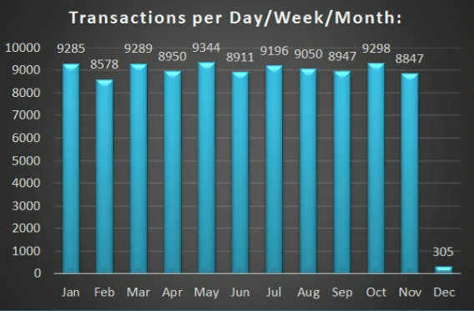
Transactions analysis (Day-wise, Week-wise, Month-wise)
Analysis:
Column Chart: Which represents total number of transactions Volumes
Insight:
• May is the busiest month by transaction count, while Jan leads by total value.

Slide 7
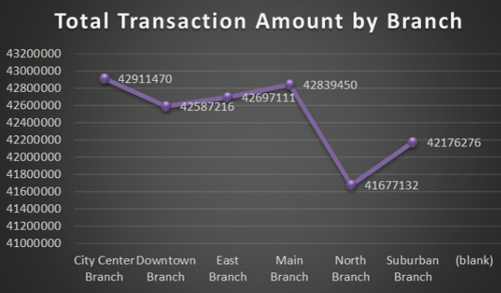
TOP PERFORMING Branch
Analysis:
Line Chart: Which represents total number of transactions amount by each branch
Insight:
• City Centre Branch leads to highest in transactions.

Slide 8
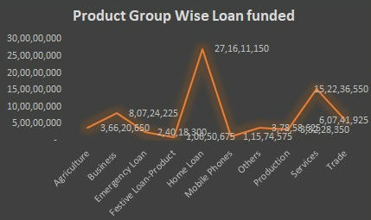
Product group wise loan funded
Analysis:
Line Chart: Which represents Product, group wise loan funded
Insight:
• According to this analysis, Bank have funded more loans to Home Loan customer which plays a Big role when compared to other loan funded

Slide 9
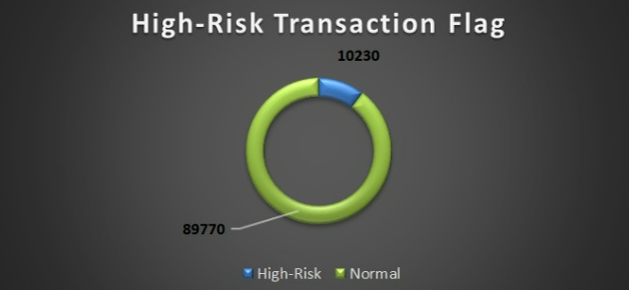
High Risk analysis
Analysis:
Pie Chart: Which represents High-Risk transactions done by the customers. Frequent customer disputes for refunds, often seen as a liability.
Insight:
• According to this analysis, High-risk transaction account for 10% from the total transaction.

Slide 10
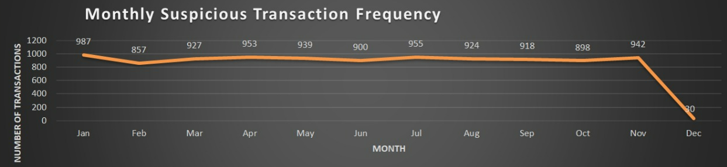
ANALYSIS OF Suspicious transaction
Analysis:
Line Chart: This shows suspicious transactions made by month.
Insight:
• This study reveals that January has the largest number of suspicious transactions (987), while December has the lowest number of suspicious transactions. This shows suspicious transactions made by month.

Slide 11
bank Wise Loan Summary
Analysis:
Bar Chart: Which represents Bank wise loan funded
Insight:
• According to this analysis, Kotak Mahindra Bank funded more loans when compared to other banks

Slide 12
Identifies transaction method distributions
Analysis:
Column Chart: Which represents transaction method distribution
Insight:
This study reveals that Debit Card has the largest number of transactions, while Bank Transfer has the lowest number of transactions.

Slide 13
Religion wise analysis
Analysis:
Pie Chart: Which represents Religion wise loan distribution
Insight:
This study reveals that Hindu Religion has taken more fund while other religion has the lowest loan amount distributions.

Slide 14
Age group wise analysis
Analysis:
Area Chart: Which represents Age group wise analysis
Insight:
This study reveals that between 26 to 35 age group, who takes more loan then compared to other age group.
Banks and financial institutions heavily target the 26 to 35 age group—often referred to as young professionals or early-stage millennials—because this demographic represents the "ideal" mix of high earning potential, long career longevity, and active consumption.

Slide 15

Challenges Faced During the Project
KPI Definition & Calculation: Selecting KPIs aligned with business goals required multiple revisions and validation.
Tool Integration Challenges: Ensuring consistent data logic and metrics across Excel, SQL, Power BI and Tableau.
SQL Query Complexity: While loading the file their was a error, took very long time to find out the error and rectify it.
Dashboard Design Decisions: Choosing appropriate visuals while maintaining clarity and avoiding clutter.

Slide 16

Key Learnings and Takeaways
End-to-End Data Handling: Learned how raw data moves from extraction to the final dashboard.
Practical SQL Skills: Gained hands-on experience in writing queries, joins, filtering and aggregations.
KPI-Oriented Thinking: Learned to think from a business perspective rather than only technical output.
Visualization & Storytelling: Understood how dashboards should communicate insights clearly to stakeholders.
Problem-Solving: Learned to troubleshoot errors and improve outputs through continuous refinement.

Slide 17
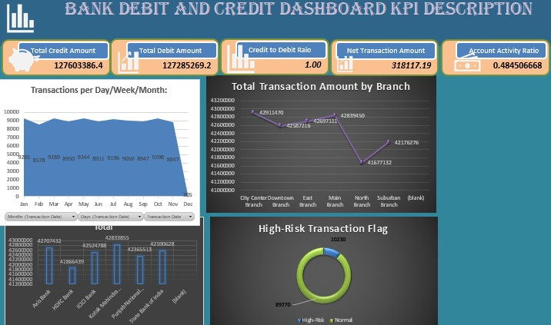
EXCEL
Bank Debit & Credit Dashboard
1 / 5
KPI Analysis using Microsoft Excel
KEY HIGHLIGHTS
Total Credit vs Debit volume: ₹1.27 Cr each
Credit to Debit Ratio maintained at 1.0
Branch-wise transaction amount comparison
High-Risk Transaction Flag: 10% flagged
CHALLENGES FACED
Managing 10,000+ rows without performance lag
Building dynamic pivot charts with slicers
Linking KPI cards to live data using named ranges
Formatting dashboards to fit one printable screen
Excel
Bank Debit & Credit Dashboard — KPI Analysis using Microsoft Excel
Notes:
3

Slide 18
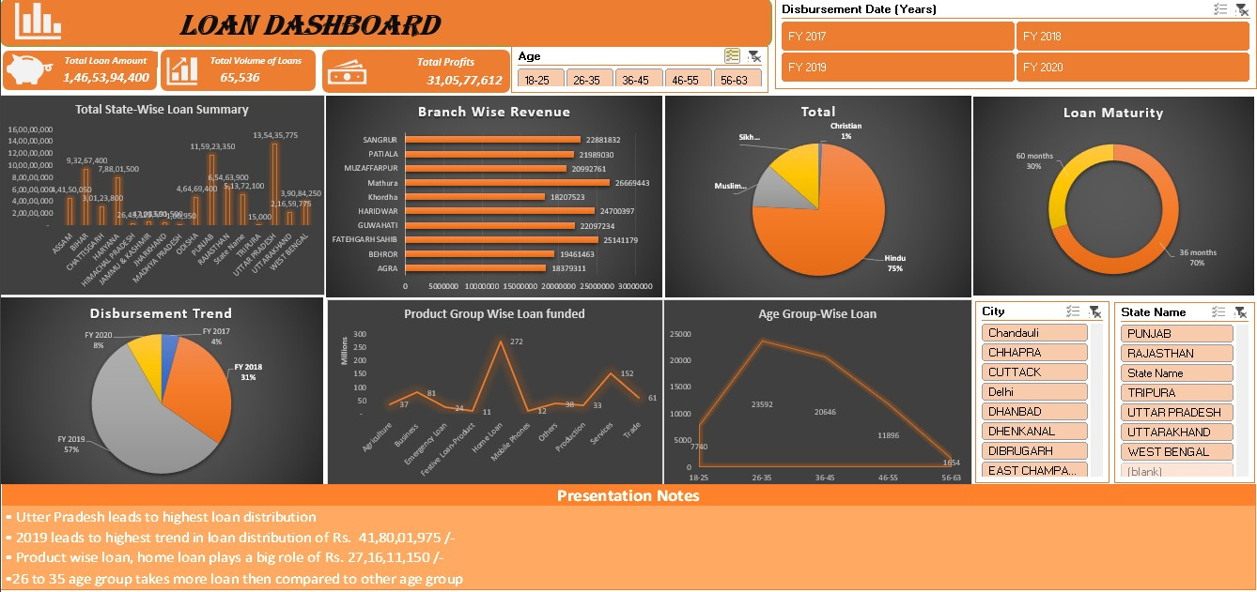
Loan Dashboard
EXCEL
4 / 5
Data Extraction & Reporting using SQL
KEY HIGHLIGHTS
Branch-wise revenue breakdown with totals
Age-group and product-group loan segmentation
Disbursement trend analysis across FY 2017–2020
Loan maturity & religion-wise distribution
CHALLENGES FACED
Writing multi-level nested subqueries for aggregation
Handling NULL values across joined tables
Optimizing slow queries on 50,000+ record datasets
Grouping and pivoting data without native PIVOT support
Loan Dashboard — Data Extraction & Reporting using SQL
Notes:
6

Slide 19
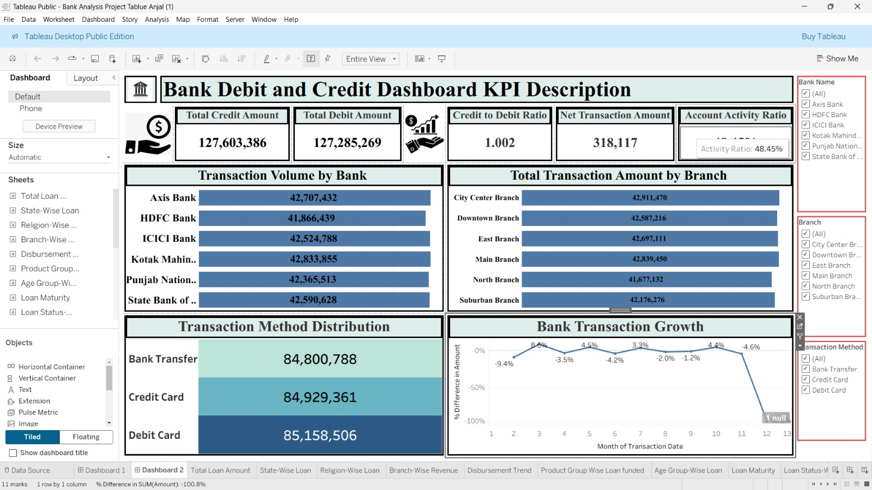
TABLEAU
Bank Debit & Credit Dashboard
3 / 5
Multi-dimensional Loan Analysis using Tableau
Notes:
5

Slide 20
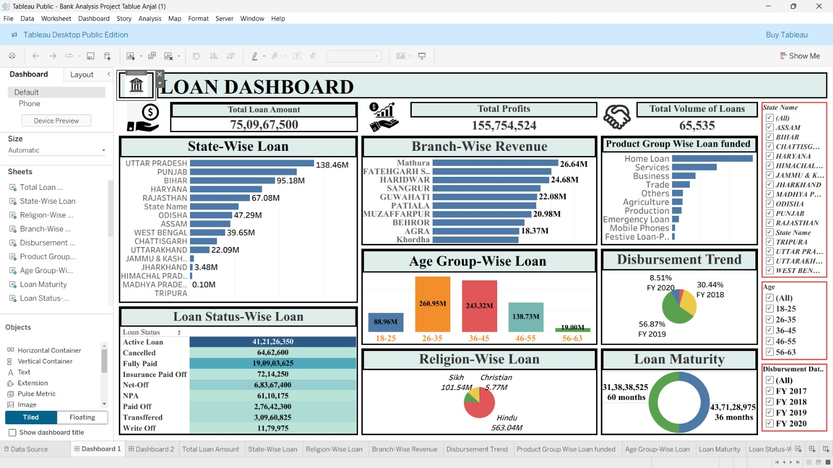
TABLEAU
Loan Dashboard
3 / 5
Multi-dimensional Loan Analysis using Tableau
Notes:
5

Slide 21
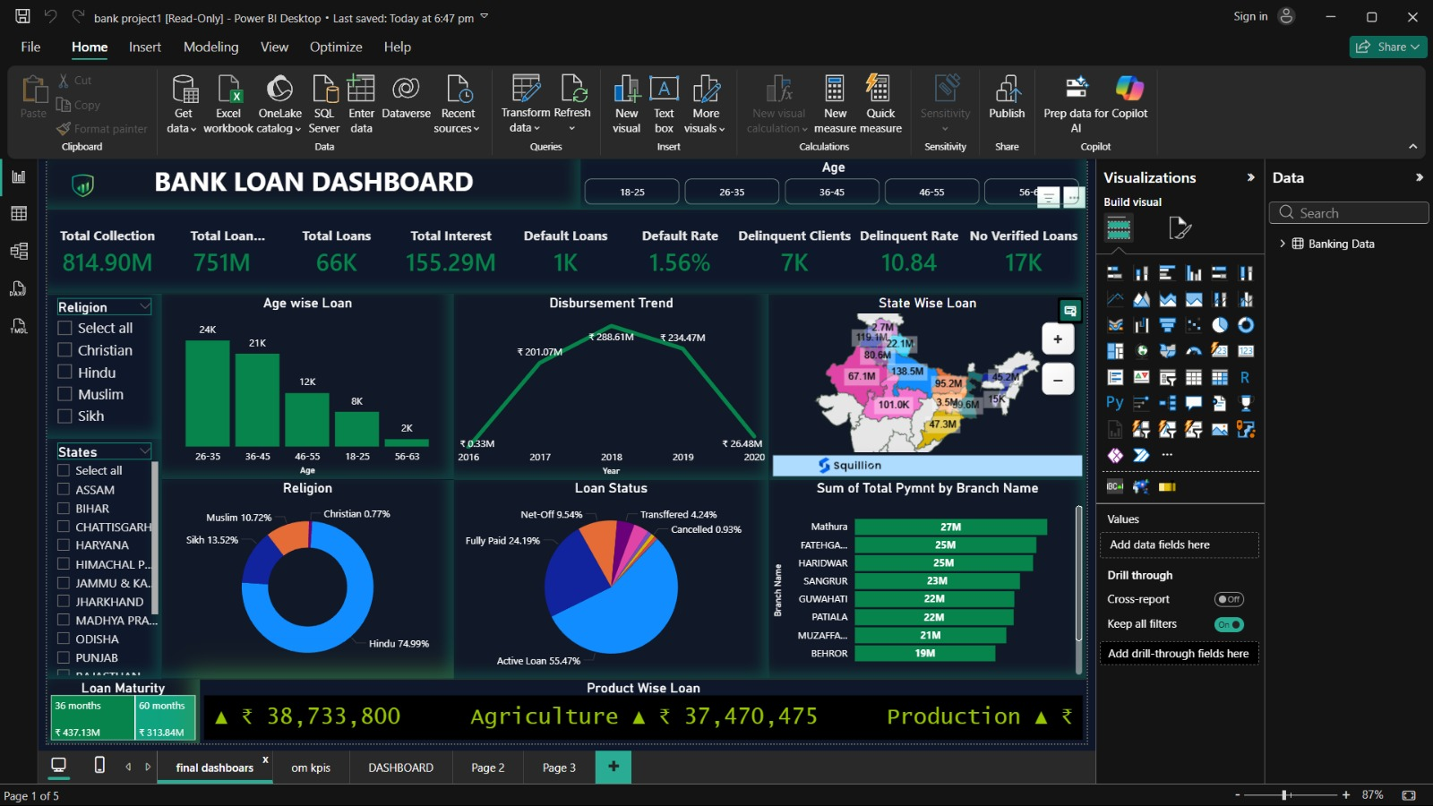
Power BI
Bank Debit & Credit Dashboard
3 / 5
Multi-dimensional Loan Analysis using Tableau
Notes:
5

Slide 22
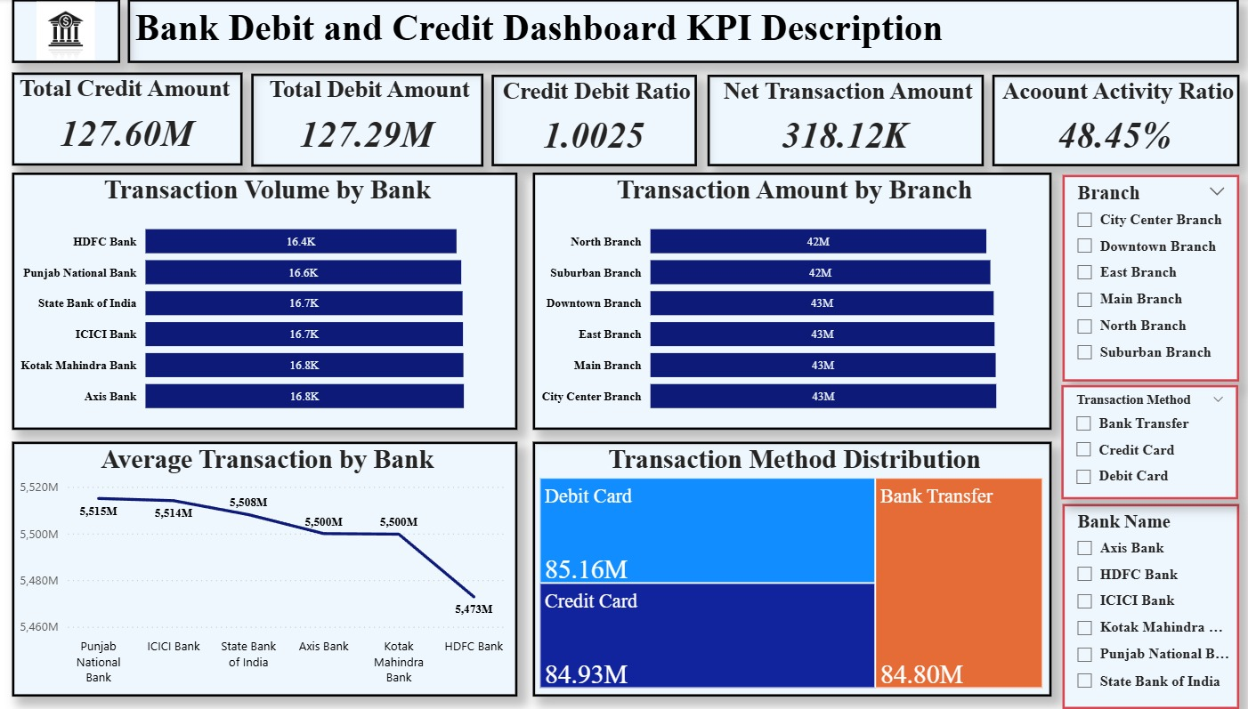
TABLEAU
Loan Dashboard
3 / 5
Multi-dimensional Loan Analysis using Tableau
Notes:
5

Slide 23
THANK YOU
Group Presentation — Data Analytics Capstone
S• Om Haraniya
ExcelR Data Analytics Training | Capstone Projects | 2026
Excel • Power BI • Tableau • SQL
Notes:
8

